Slide 1
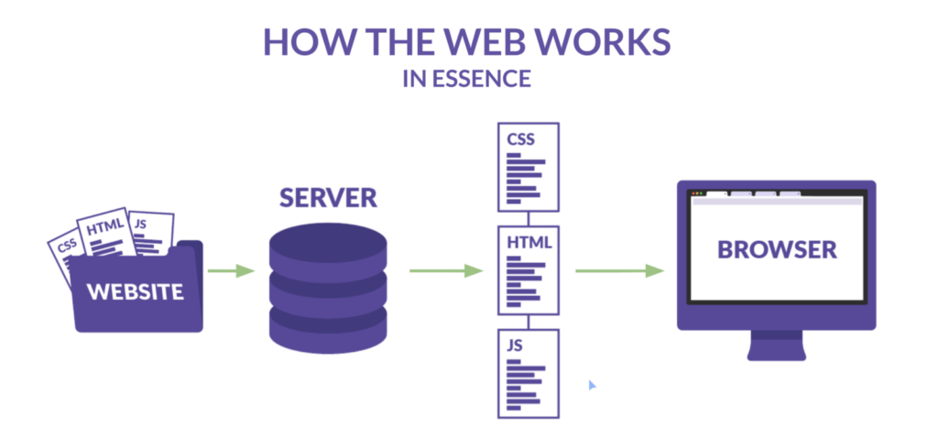
How does the web work?
client

Slide 2
What do you need to be a web developer?
To be a web developer, first we need to be creative artists and have skills of the three languages: HTML, CSS and JavaScript.
Second we need to know program a web page
Program a server
Program a data base

Slide 3

What is the role of a web developer.

Slide 4
The role of web developer is to fix bugs and and developing new features and websites , they also may work with other web developers to discuss and solve problems ,in the other hand they could work on some new projects (websites) on scratch or work on an existing website and make it better.

